Slide 1
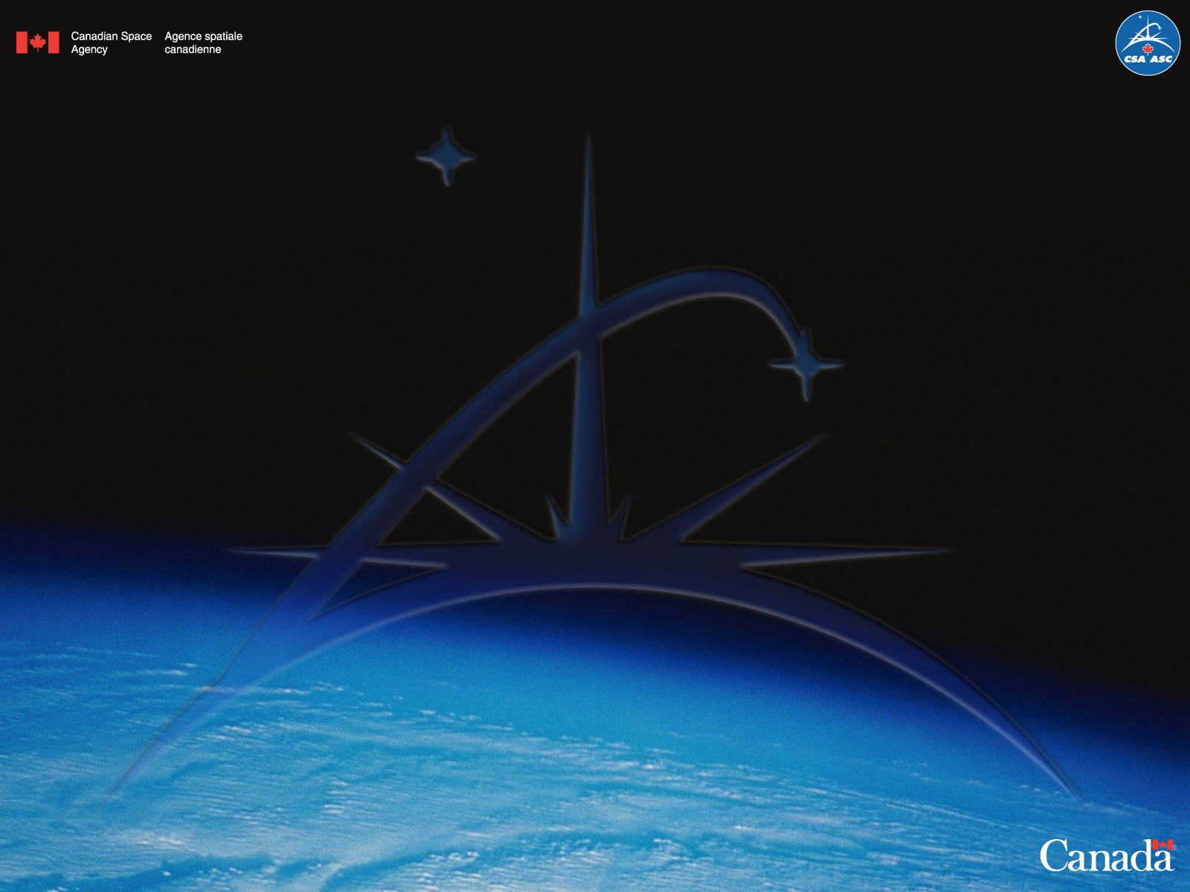
Symphony
Multi-Mission Software Framework
RobotIQ
April 2015
Régent L’Archevêque
Pierre Allard
Notes:
1

Slide 2
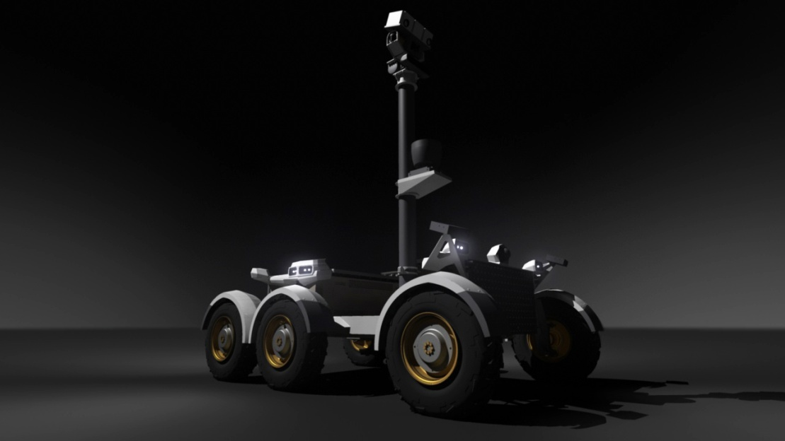
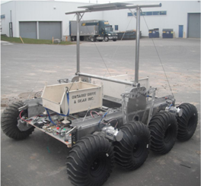
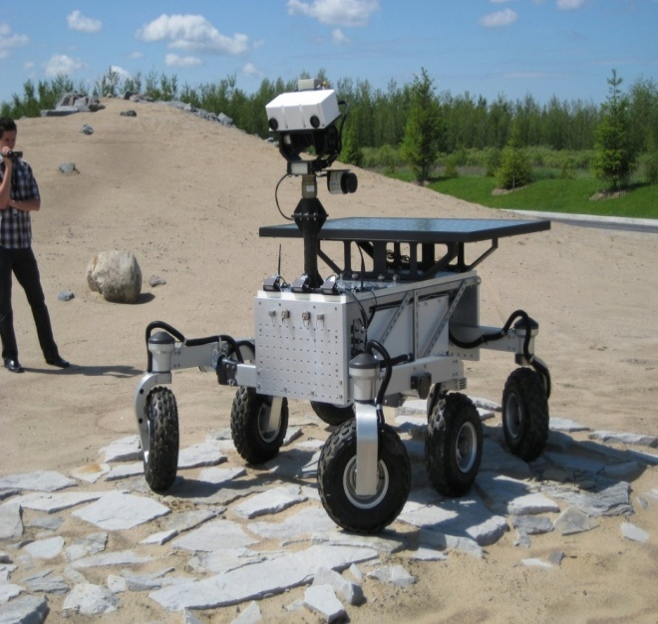
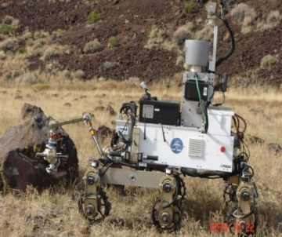
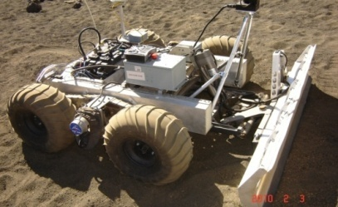
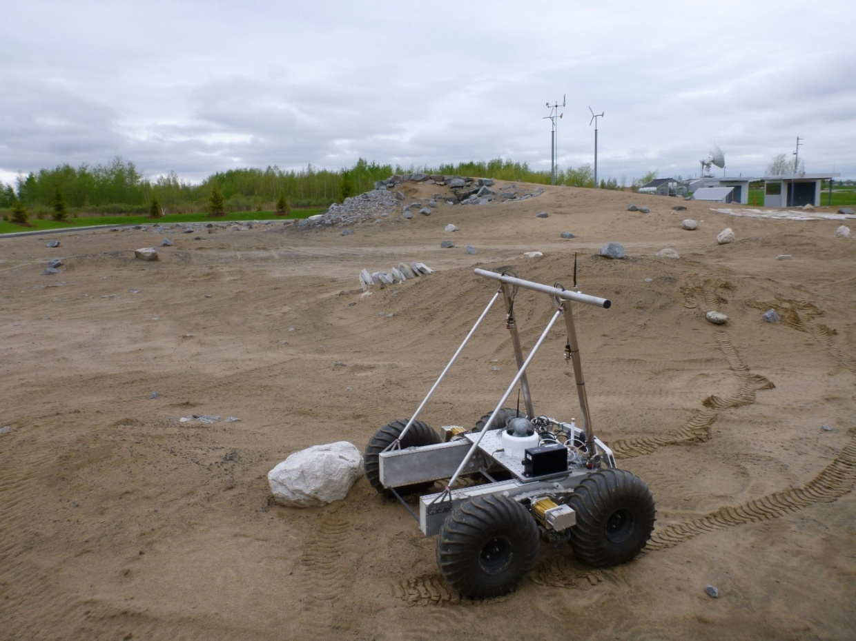
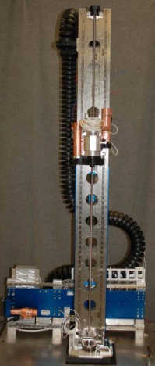
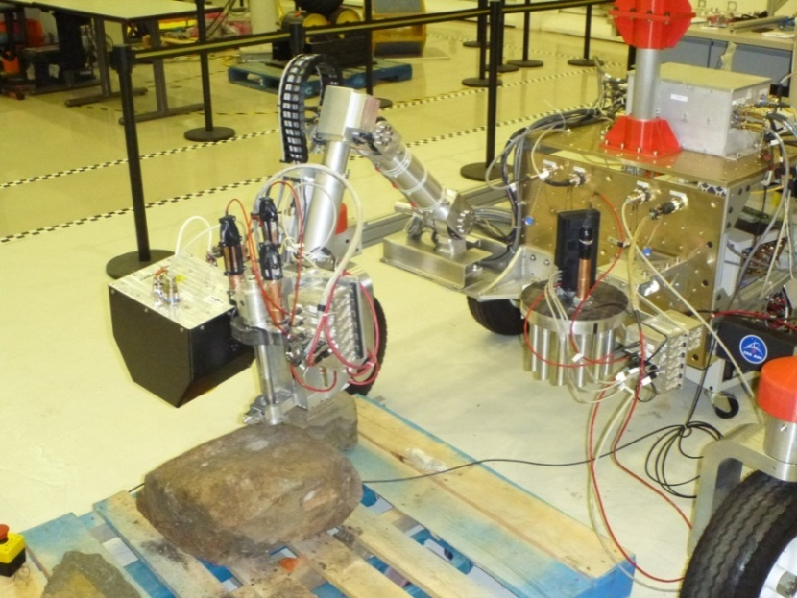
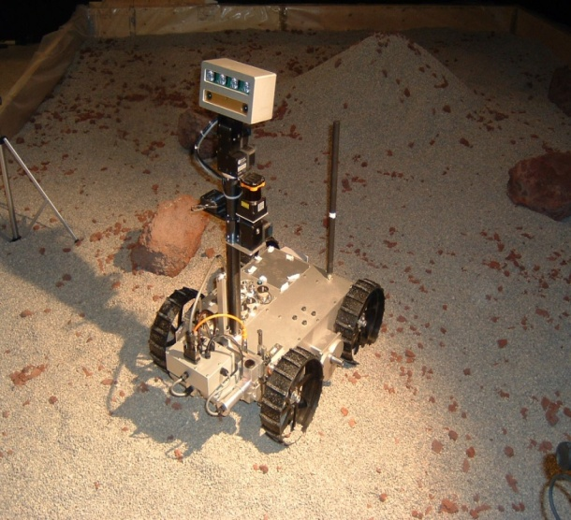
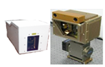
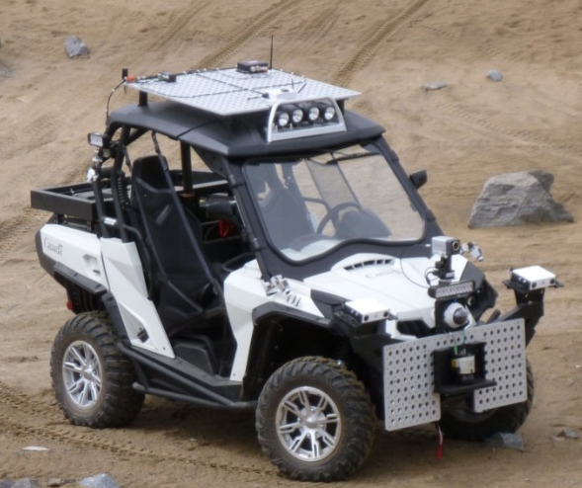
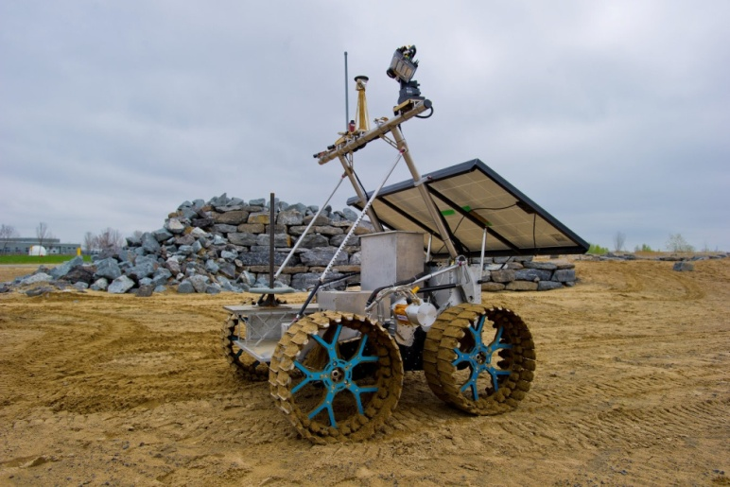
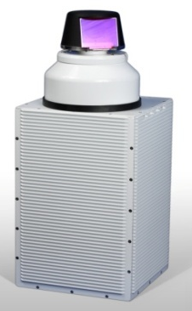
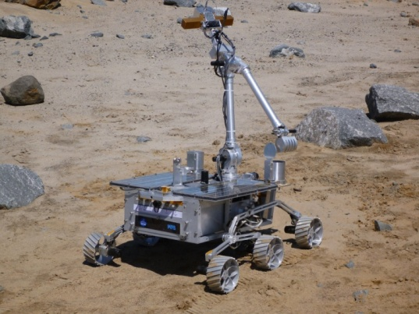
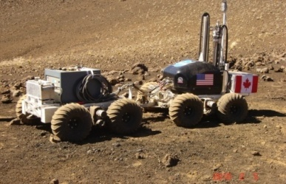
CSA Rovers & Instruments
2

Slide 3

A tool to plan, validate, execute and monitor integrated operations to support multiple missions
A component-based architecture that allows instruments and rovers to “plug-in”
Organizationally neutral core framework
Maximizes reuse between missions
Symphony is NOT a simulator BUT can integrate one

Slide 4
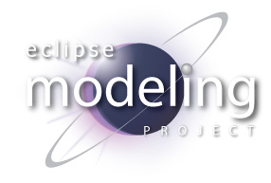






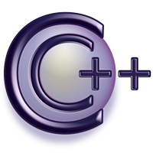
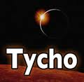

Eclipse Technologies

Slide 5
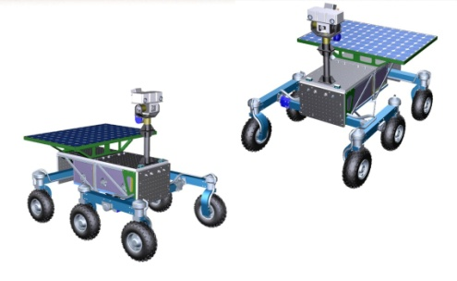
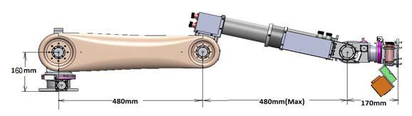
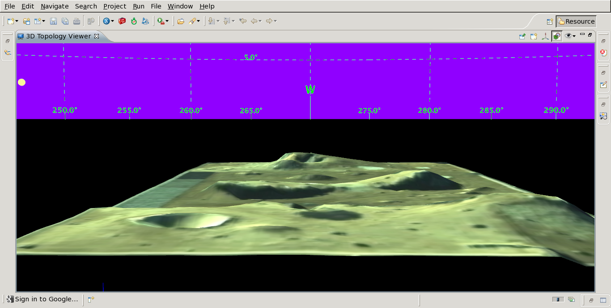
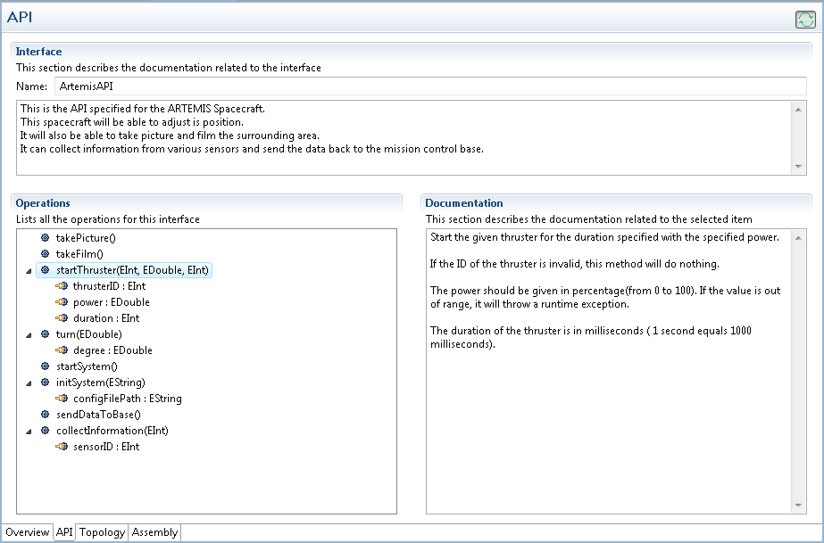







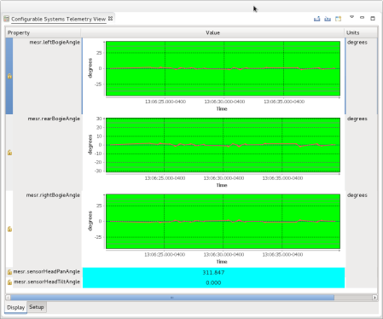
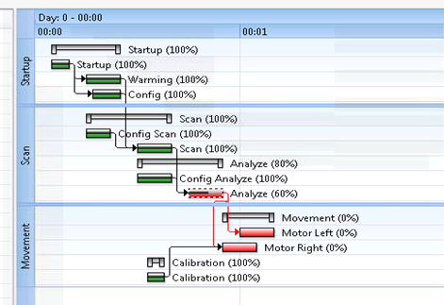

Symphony Concept

Slide 6

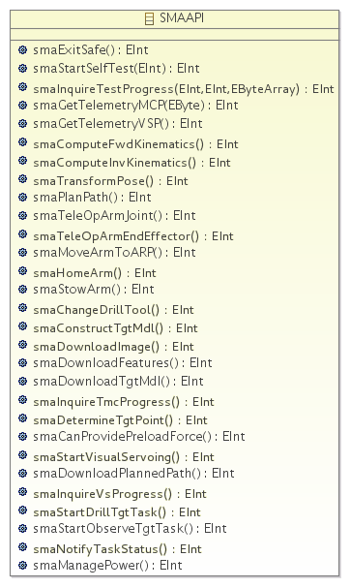
Systems

Slide 7

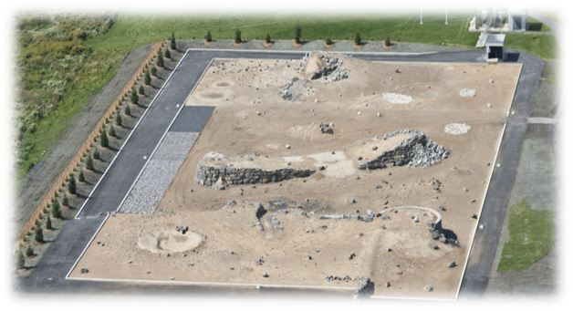
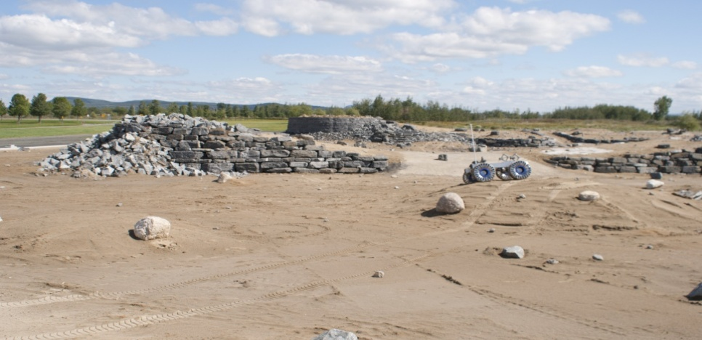

Environment

Slide 8

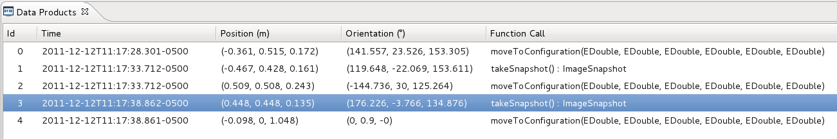
Operations

Slide 9
Symphony Core Capabilities
System
Command
Telemetry
Environment
Surface Worksite
Orbital Worksite
Operations
3D Model
Assembly
Hand-Controllers
Ops Contexts
Resources Modeling
Data Products
Scripts
Distributed Collaboration

Slide 10
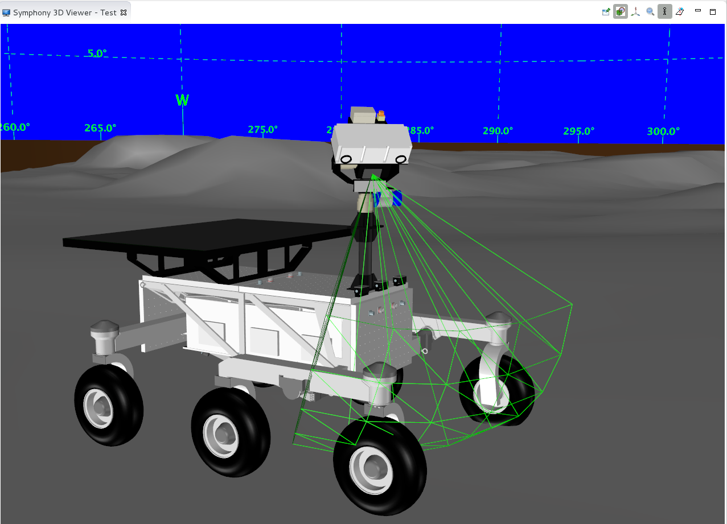
MESR 3D Model

Slide 11
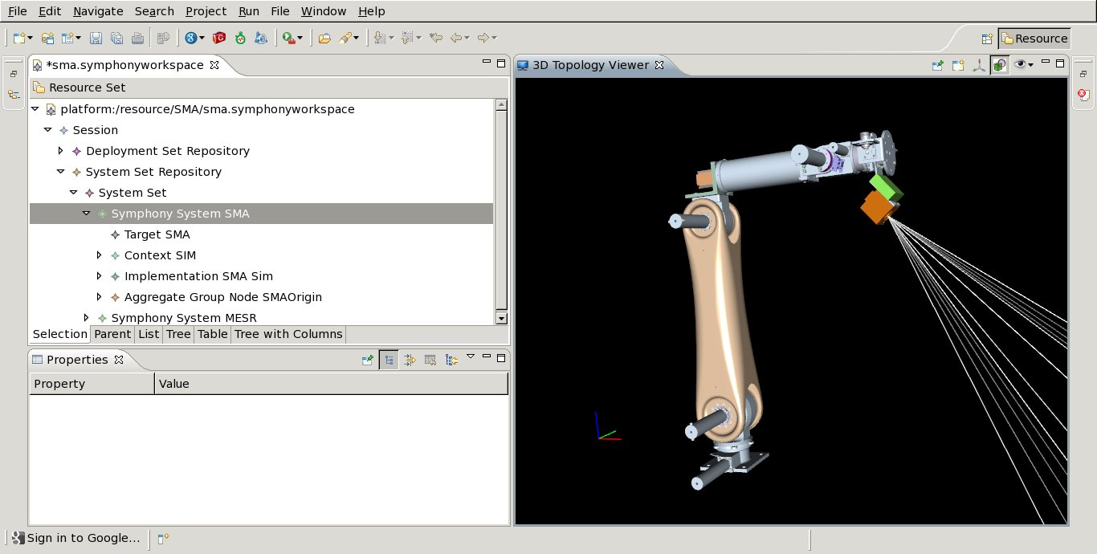
Planetary Medium Manipulator

Slide 12
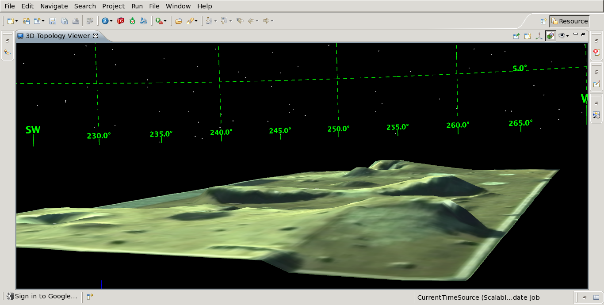
Environment Modeling

Slide 13
IP
CSA Applications (CSA)
Industry & Academia Applications
Symphony (CSA)
CSA Libraries (CSA)
Off The Shelf (EPL, Apache, no GPL)
Eclipse SDK (EPL)

Slide 14
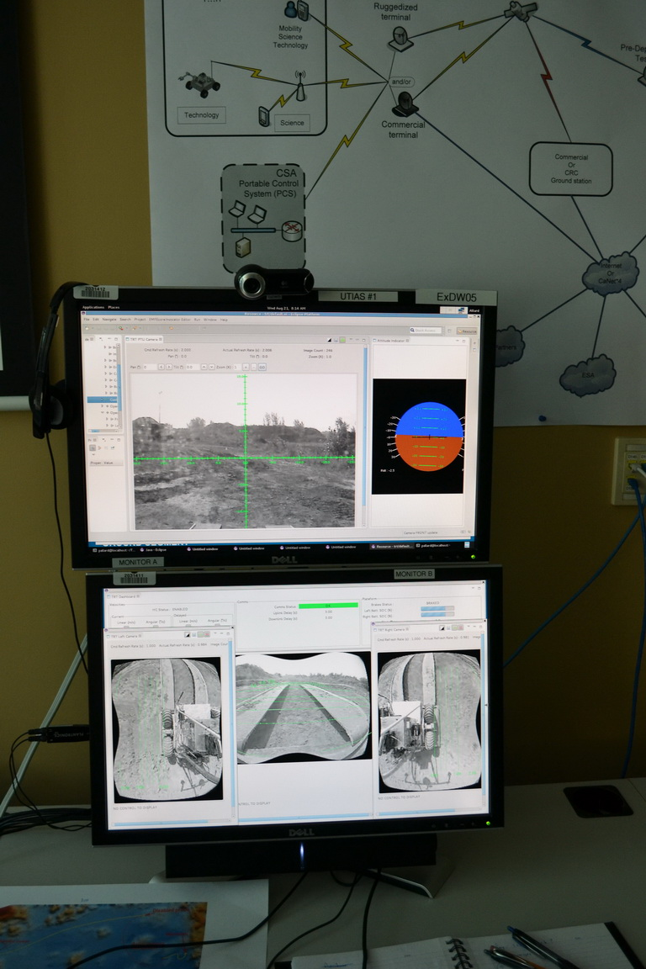
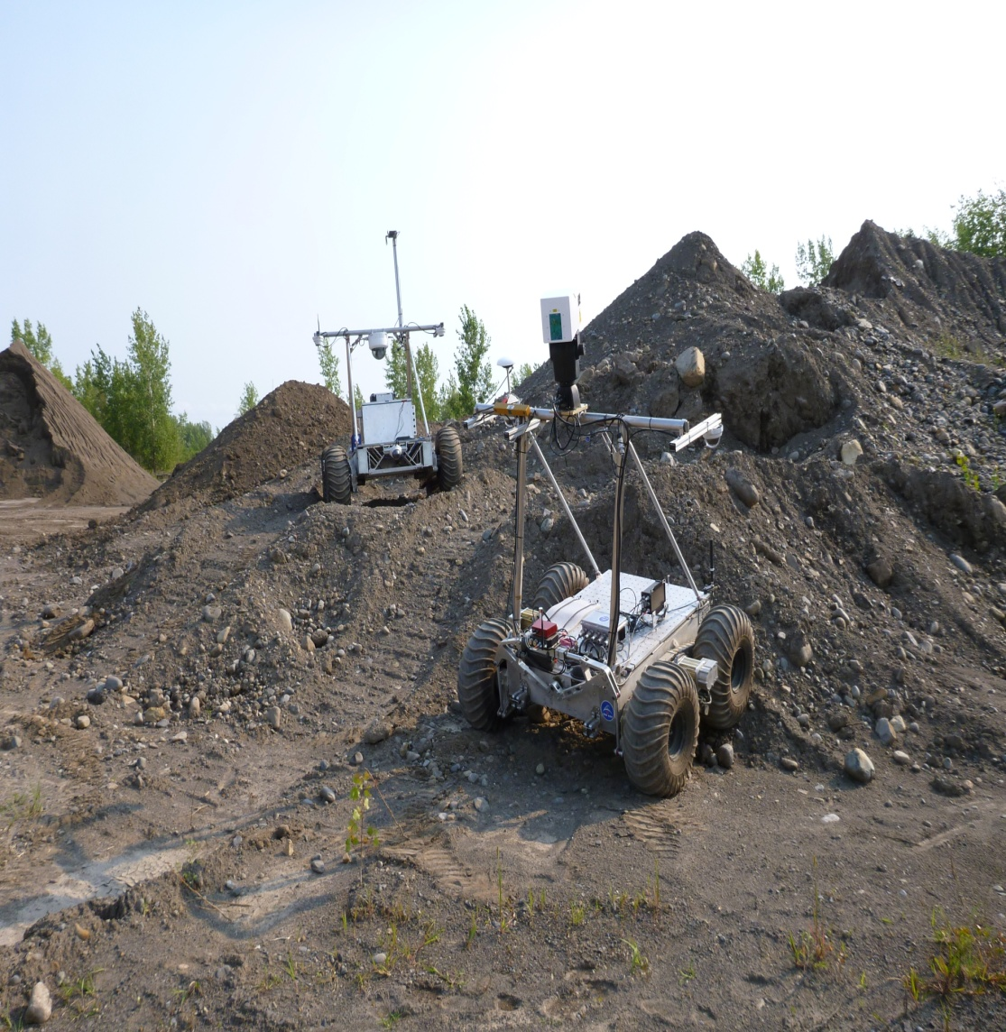
Mercier 2013 Deployment

Slide 15
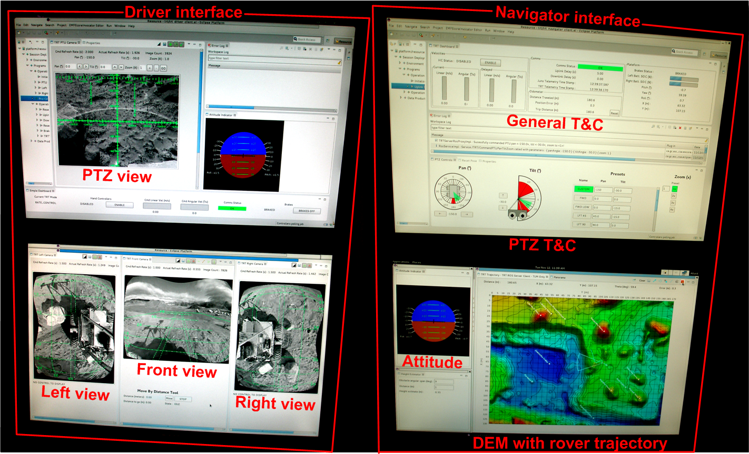
Deployments 2014

Slide 16
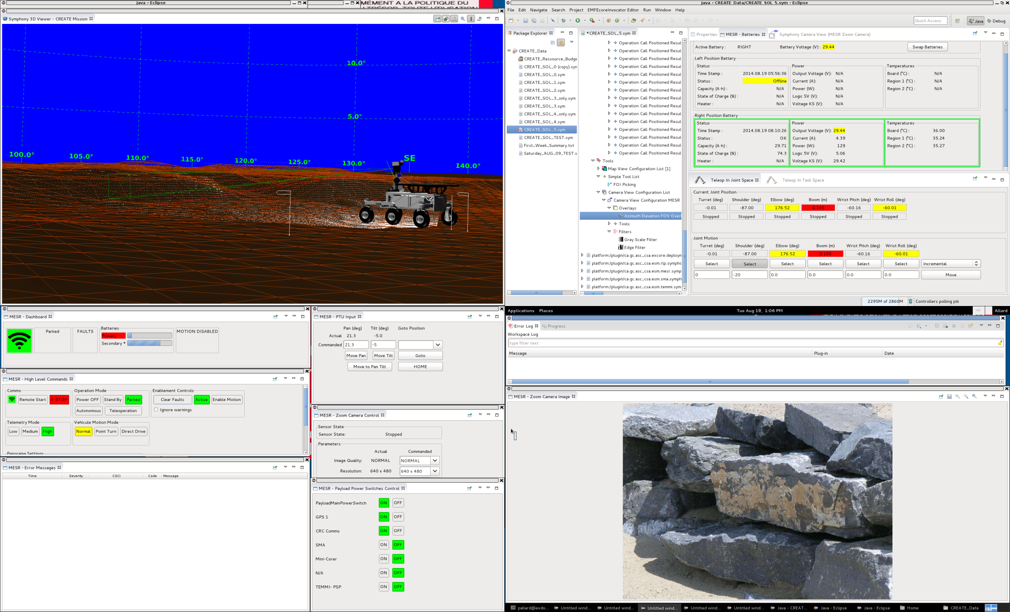
Deployments 2014

Slide 17
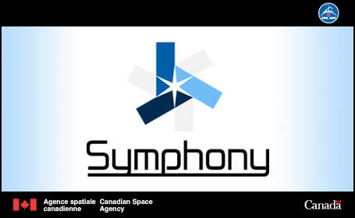
Summary
One integrated mission operation tool
Fast operation planning & analysis
Re-usable and extendable framework

